Slide 1
Managerial Economics and Financial Analysis
D. MAHESWARI
Assistant Professor
Department of Information Technology
Aditya Engineering College (A)
Email: Maheswari.dama@aec.edu.in

Slide 2
ISOQUANTS:
The term Isoquants is derived from the words „iso‟ and „quant‟ – „Iso‟ means equal and „quant‟ implies quantity. Isoquant therefore, means equal quantity.
Isoquants are the curves, which represent the different combinations of inputs producing a particular quantity of output. Any combination on the Isoquant represents the some level of output.

Slide 3
For a given output level firm’s production become,
Q= f (L, K) Where
Q, is the units of output is a function of the quantity of two inputs L and k. Thus an Iso quant shows all possible combinations of two inputs, which are capable of producing equal or a given level of output. Since each combination yields same output, the producer becomes indifferent towards these combinations.

Slide 4
Assumptions:
1. There are only two factors of production, viz. labour and capital.
2. The two factors can substitute each other up to certain limit
3. The shape of the Iso quant depends upon the extent of substitutability of the two inputs.
4. The technology is given over a period.

Slide 5
Isoquants
Combinations | Labour (units) | Capital (Units) | Output (quintals)
A | 1 | 10 | 50
B | 2 | 7 | 50
C | 3 | 4 | 50
D | 4 | 4 | 50
E | 5 | 1 | 50
An Isoquant may be explained with the help of an arithmetical example.

Slide 6
Labour is on the X-axis and capital is on the Y-axis. IQ is the ISO-Product curve which shows all the alternative combinations A, B, C, D, E which can produce 50 quintals of a product. An isoquant (equal quantity) is a curve that shows the combinations of certain inputs such as Labor (L) and Capital (K) that will produce a certain output Q. Mathematically, the data that an isoquant projects is expressed by the equation
f (K,L) = Q

Slide 7
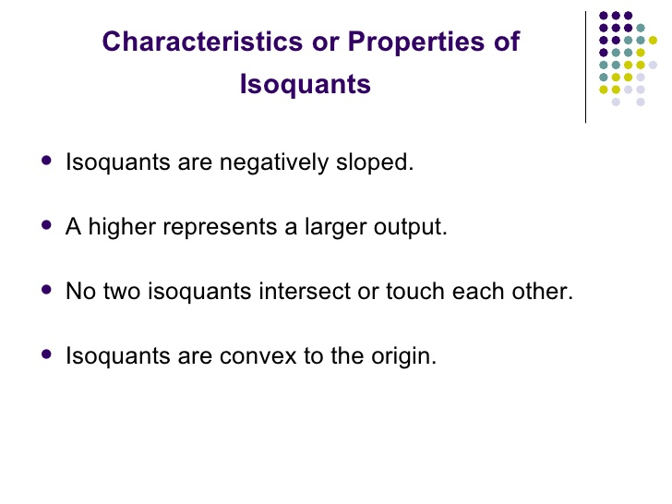

Slide 8
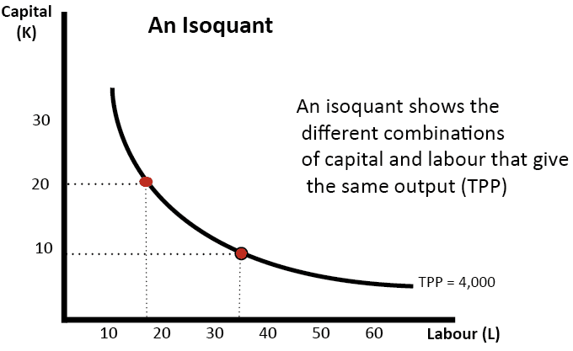
ISO QUANTS

Slide 9
Types of iso quants
Right angle iso quants
Linear iso quants
Convex iso quants

Slide 10
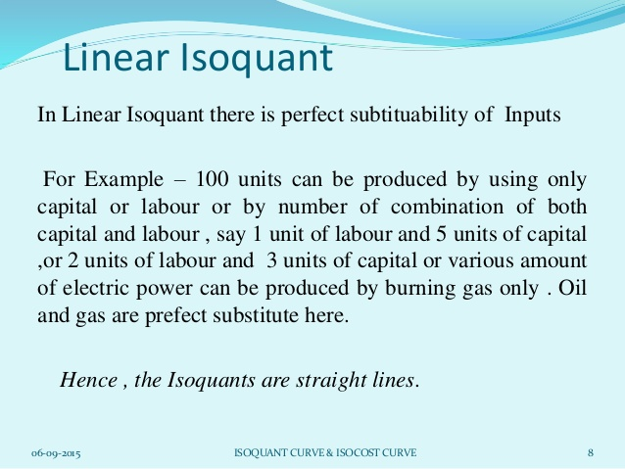
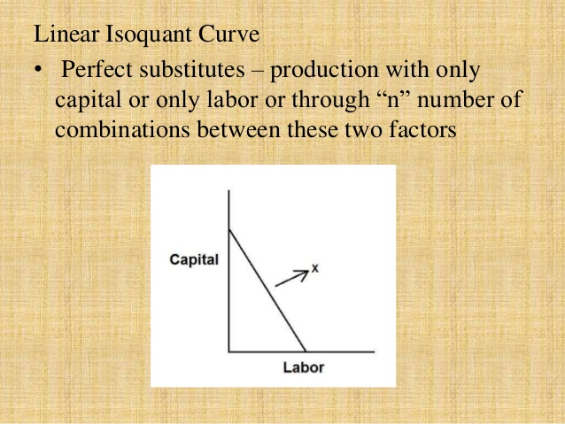

Slide 11
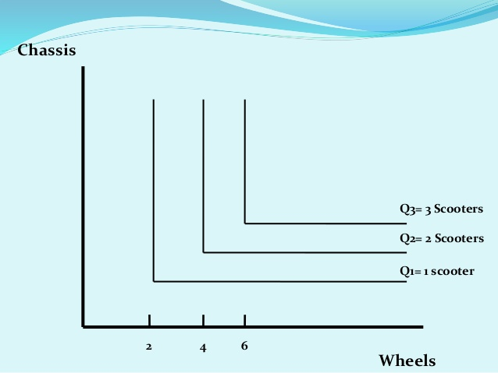
Right angle iso quants

Slide 12
Convex ISO QUANTS

Slide 13
Marginal Rate of technical Substitution
The MRTS tells us how much of one input a firm can sacrifice while still maintaining a certain output level.
MRTS (L for K)= -dK/dL = Example: When going from point B to A in the Slope = (3 units of Capital)/(-1 units of Labor). The MRTS (L for K) = -(3/-1) = 3/1 between points B and A, which means that 3 units of Capital can substitute for 1 units of labor.
MRTS is defined as the units of one input factor that can be substituted for a single unit of the other input factor.

Slide 14
Iso cost
Example: A company producing widgets encounters the following costs- cost of capital is $25000, labour cost is $15000, and the total cost the firm is willing to pay is $40,000
An isocost line is a graphical representation of various combinations of two factors (labor and capital) which the firm can afford or purchase with a given amount of money or total outlay. It is an important tool for determining what combination of factor-inputs the firm will choose for production process.

Slide 15
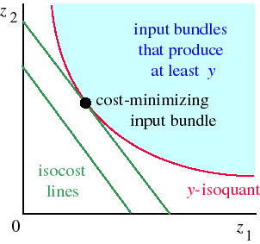
Iso cost graph

Slide 16
Least Cost Combination of Inputs A given level of output can be produced using many different combinations of two variable inputs. In choosing between the two resources, the saving in the resource replaced must be greater than the cost of resource added. The principle of least cost combination states that if two input factors are considered for a given output then the least cost combination will have inverse price ratio which is equal to their marginal rate of substitution.

Slide 17
Producer‟s Equilibrium:
The tem producer‟s equilibrium is the counter part of consumer‟s equilibrium. Just as the consumer is in equilibrium when be secures maximum satisfaction, in the same manner, the producer is in equilibrium when he secures maximum output, with the least cost combination of factors of production. The optimum position of the producer can be found with the help of iso-product curve. The Isoproduct curve or equal product curve or production indifference curve shows different combinations of two factors of production, which yield the same output. This is illustrated as follows. Let us suppose. The producer can produces the given output of paddy say 100 quintals by employing any one of the following alternative combinations of the two factors labour and capital computation of least cost combination of two inputs.

Slide 18
Labour | Capital | Out put | Labour cost | Cost of capital | Total cost
10 | 45 | 100 | 30 | 180 | 210
20 | 25 | 100 | 60 | 112 | 172
30 | 16 | 100 | 90 | 64 | 154
40 | 12 | 100 | 120 | 48 | 168
50 | 8 | 100 | 150 | 32 | 182

Slide 19
Thank you

